Slide 1

Web Scraping Project
Realtor.ca
Cindy Lo
Feb 2024

Slide 2




Web Scraping Guideline: Realtor Market
Motivation
Data
Challenges
Conclusion
Notes:
This project is to give you a guideline of current market trends for people who are 1st time home buyer, investors, or renters. By the end of this presentation, you will have a basic idea of current price trends in Greater Toronto Area, where and what to look for, and the return of investment and cash flow you can prepare

Slide 3

Data: gold
Market: volatile
Type: Public
Industry: real estate
Owned by Canadian Real Estate Association (CREA)
Most popular and trusted website in Canada
Products: find buy/sell/rent properties
Find a realtor nearby
Mortgage calculators
Daily blog
Motivation

Slide 4
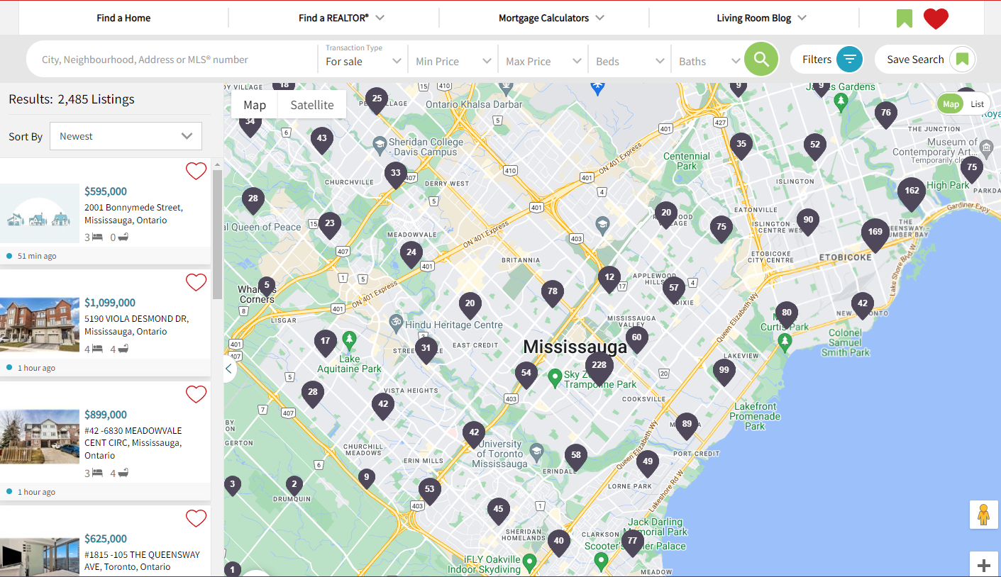

Slide 5
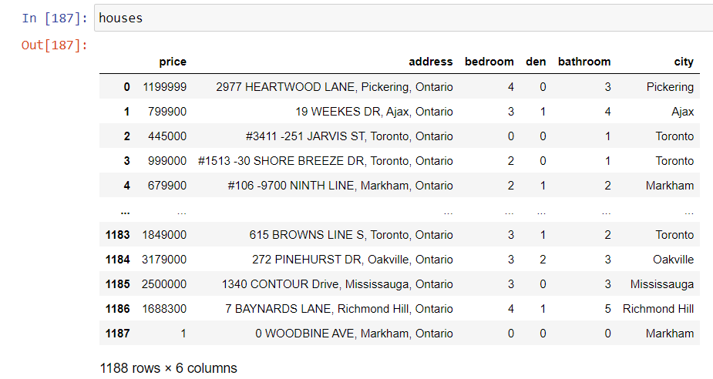
Data Extraction
Total data record: 1188
Location: Greater Toronto Area
List of columns: 6
Timeframe: Feb 24, 2024 6 p.m.
20XX | 20XX | 20XX | 20XX

Slide 6
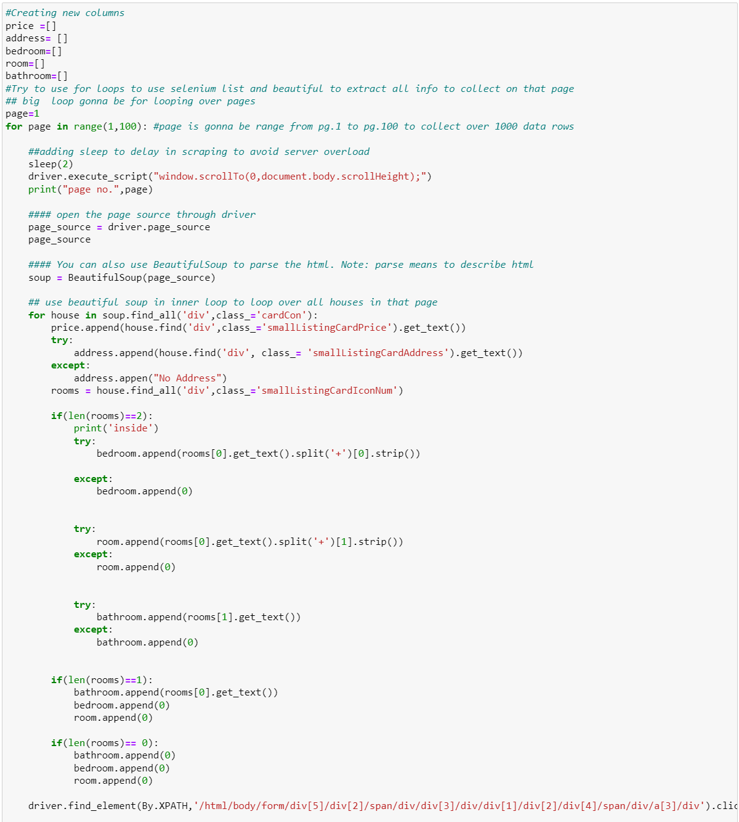
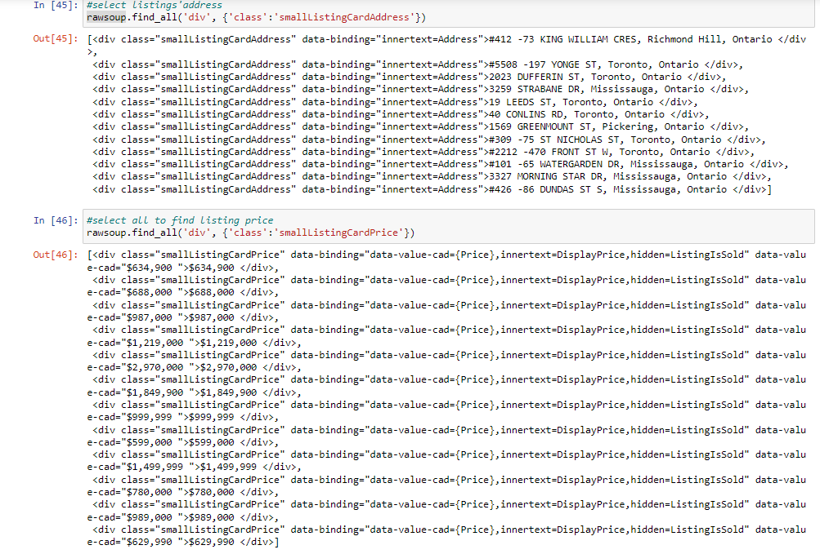
Raw vs. Clean Data
Python:Selenium & Beautifulsoup

Slide 7
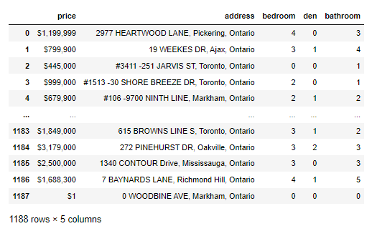
Filtered and Cleaned Data: Dataframe

Slide 8
Software Used:
Python
Anaconda
Jupyter Notebook
Libraries Used:
Panda
Time
Numpy
Selenium webdriver
Beautifulsoup
Data Visualization Tool Used:
Matplotlib.pyplot
%matplotlib inline
Matplotlib.colors
Plotly
Seaborn
Re
Random

Slide 9

Data Visualization
Show how the current market in Greater Toronto Area

Slide 10
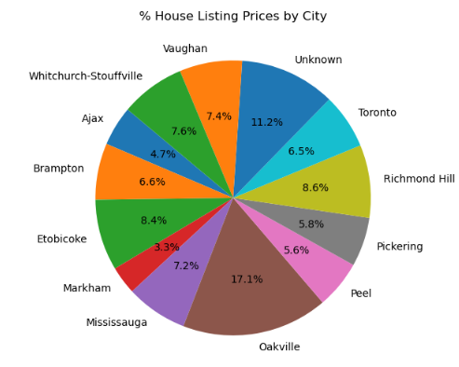

Slide 11
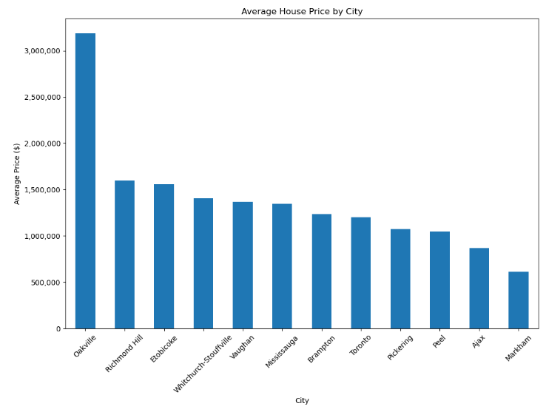

Slide 12
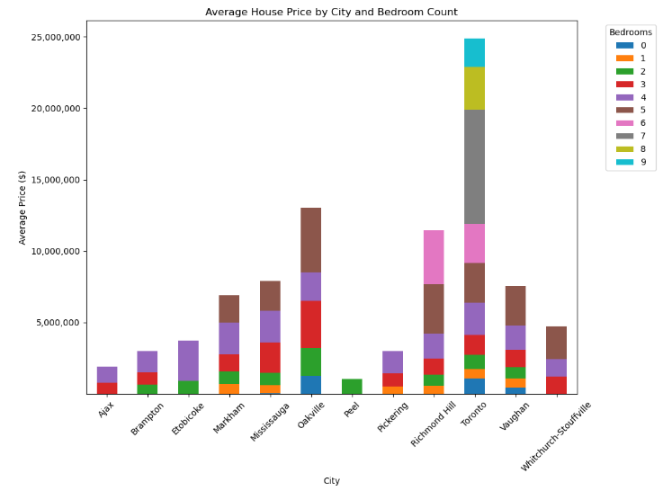

Slide 13
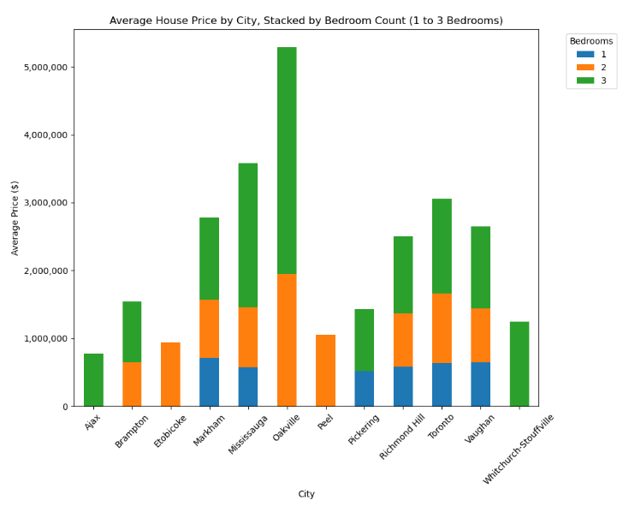

Slide 14
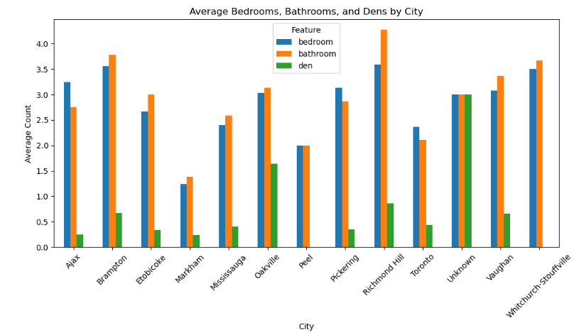

Slide 15
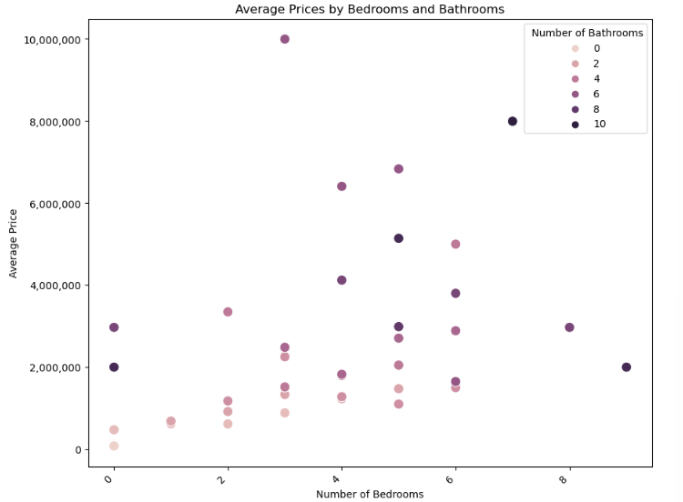

Slide 16
Extract Data Stage
Progress to show the % completion in extract, transform, loading data (ETL)
Extract Data
Filter Data
Visualize Data
Fixing data bugs
Loading Data
Extract raw data from Realtor.ca
Select relevant and useful data from coding
Present the data that is useful to audience
10% | 20% | 30% | 40% | 50% | 60% | 70% | 75% | 80% | 85% | 90% | 100%
Transform data through charts
Coding index and HTML errors

Slide 17
Conclusion
Oakville is the most expensive
Markham is the least expensive
Richmond Hill has most bathrooms
Richmond Hill and Markham has most bedrooms

Slide 18

Challenges
Same variable name
Gather/transform data
Create charts for big data
Bugs/ errors
Deadline
One person project

Slide 19
Next Steps
Speculate property price in real estate market
Practice coding in automating data: web scraping
Add more columns: condo, houses
Get data from different sites in comparison
Group data collected in this project with future data to create trendline

Slide 20

Thanks!

